Slide 1
React Redux Vs Context Api
Anju munoth

Slide 2
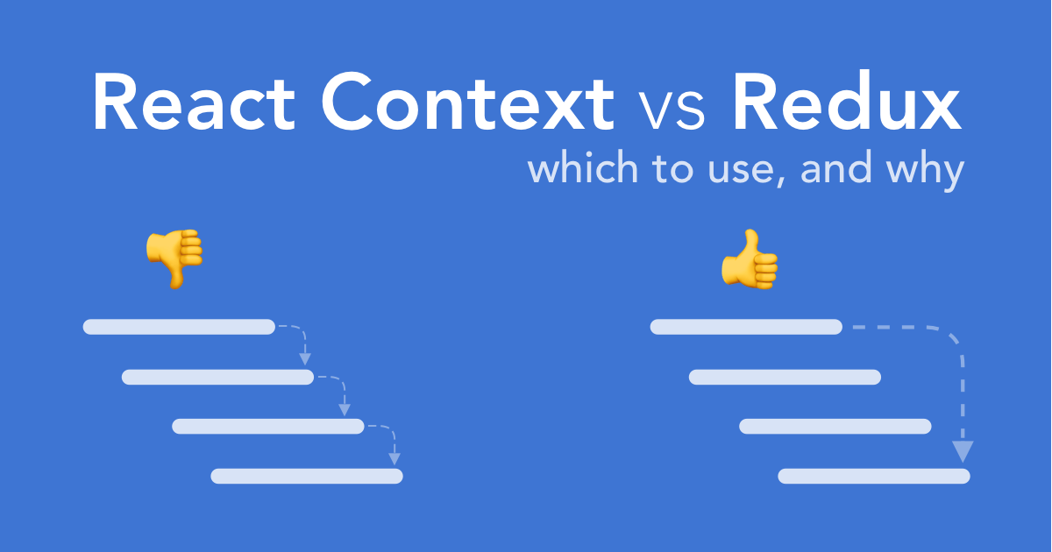

Slide 3
Agenda
>> Why state management
>> What is Redux and how to use it
>> What is Context and how to use it
>> Difference between Redux and Context
>> When to go for what

Slide 4
State Management
“Redux is a predictable state container for JavaScript apps.”
“Context provides a way to pass data through the component tree without having to pass props down manually at every level.”.

Slide 5
Redux
Redux -helps giving each React component the exact piece of state it needs.
Redux holds up the state within a single location.
Also with Redux the logic for fetching and managing the state lives outside React.

Slide 6
When to use Redux
Should consider using Redux when:
Multiple React components needs to access the same state but do not have any parent/child relationship
Start to feel awkward passing down the state to multiple components with props
Require a single source of all of the data in the application
Can be synchronous or be made asynchronous using Redux Thunk or saga.

Slide 7
Redux in short
Redux store is like a brain: it’s in charge for orchestrating all the moving parts in Redux
State of the application lives as a single, immutable object within the store
As soon as the store receives an action it triggers a reducer
Reducer returns the next state

Slide 8
Working with Redux
Packages needed
React
Redux : for the functions like createStore(), combineReducer()
React-Redux : contains the methods like useDispatch (used to dispatch an action) and useSelector (used to select things from the global state) Provider is also a part of React-redux.

Slide 9
Components of redux
reducer : these are functions with state and actions passed in. These work with action.type in switch cases and return the updated state it optionally needs to accept payload to work properly. Sometimes you will need to merge separate reducers before creating a store (generally in reducer folder for each reducer)
store : store is the hub of all data. It is also passed to the provider (generally created in index.js, but the combining of reducers happen in an index.js in reducer folder)
provider : a React based component which takes store as an argument (generally created in index.js)
actions : functions providing/returning payload and action type to the dispatcher which will call the required reducer. (generally created in a separate file called actions.js)

Slide 10
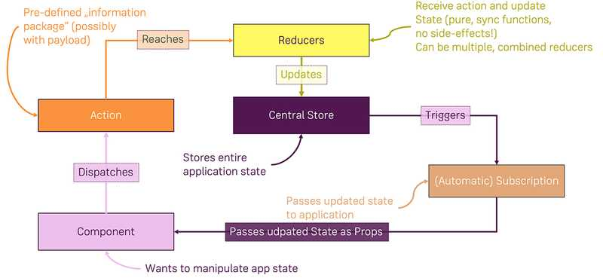

Slide 11
Context
Context provides a way to pass data through the component tree without having to pass props down manually at every level.
Context provides a way to share values like these between components without having to explicitly pass a prop through every level of the tree.

Slide 12
When to Use Context
Context is designed to share data that can be considered “global” for a tree of React components, such as the current authenticated user, theme, or preferred language.
Using context, we can avoid passing props through intermediate elements
Context is primarily used when some data needs to be accessible by many components at different nesting levels.
Context lets you “broadcast” such data, and changes to it, to all components below.
Common examples where using context might be simpler than the alternatives include managing the current locale, theme, or a data cache.
Apply it sparingly because it makes component reuse more difficult.

Slide 13
Working with Context API
Important things
provider : This is a React component with a state and it returns JSX
context : it is created using a function called createContext()
Consists of three building blocks
A Context Object
A Context Provider
A Context Consumer

Slide 14
Context.Provider
Every Context object comes with a Provider React component that allows consuming components to subscribe to context changes.
Accepts a value prop to be passed to consuming components that are descendants of this Provider.
One Provider can be connected to many consumers.
Providers can be nested to override values deeper within the tree.

Slide 15
Important note about Provider
All consumers that are descendants of a Provider will re-render whenever the Provider’s value prop changes.
Propagation from Provider to its descendant consumers (including .contextType and useContext) is not subject to the shouldComponentUpdate method, so the consumer is updated even when an ancestor component skips an update.

Slide 16
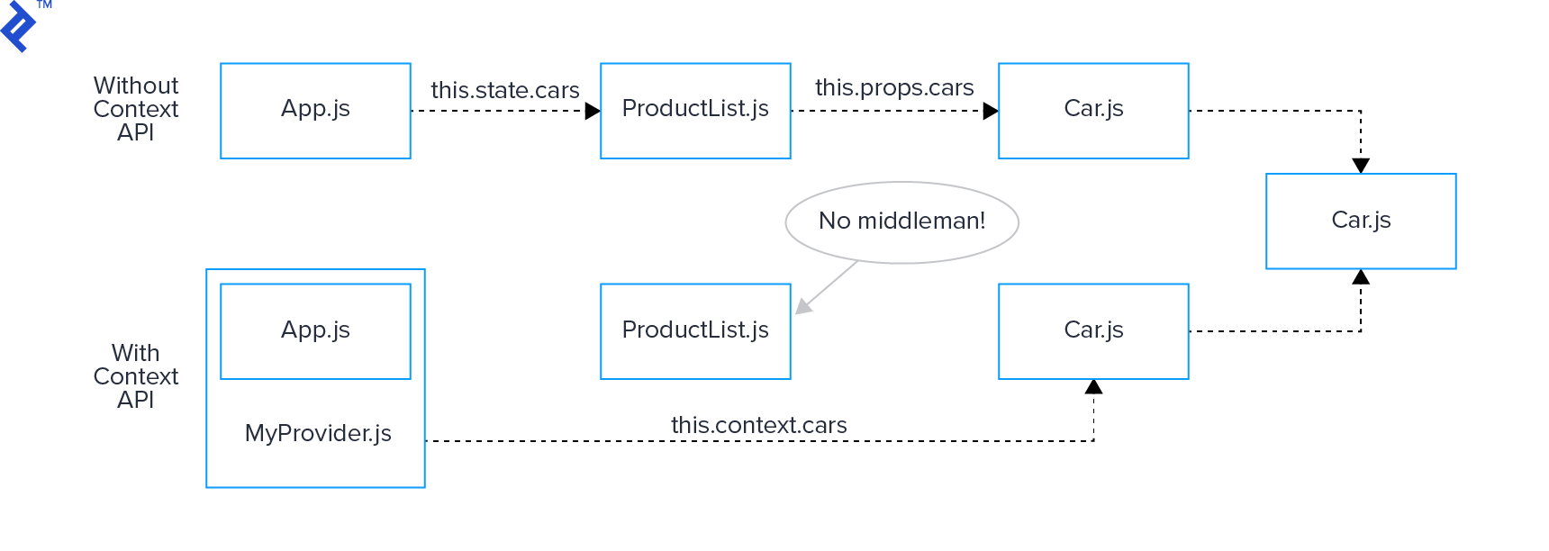

Slide 17
Easy Debugging with Redux
The ceremony of writing actions and reducers is balanced by the awesome debugging power it affords you.
With the Redux DevTools extension you get an automatic log of every action your app performed. At any time you can pop it open and see which actions fired, what their payload was, and the state before and after the action occurred.

Slide 18
Customize Redux with Middleware
Redux supports the concept of middleware, which is a fancy word for “a function that runs every time an action is dispatched.”
For instance…
Want to kick off an API request every time an action name starts with FETCH_? You could do that with middleware.
Want a centralized place to log events to your analytics software? Middleware is a good place for that.
Want to prevent certain actions from firing at certain times? You can do that with middleware, transparent to the rest of your app.
Want to intercept actions that have a JWT token and save them to localStorage, automatically? Yep, middleware.

Slide 19
Redux vs Context Api
Redux can not only be used with React but also can be used with other frameworks. Context API is the built-in app-level state management in React.
React context Provider will cause its consumers to re-render whenever the value provided changes.
Context Api is built into React and you therefore need no extra third-party dependencies - a smaller bundle and improved project maintainability are the result.
The API is also relatively straight-forward to use once you got the hang of it.
Also don’t need a package like redux-thunk to handle asynchronous actions.
Redux has the advantage to add in middleware.
Context API (currently) is not built for high-frequency updates,it’s not optimized for that.
React-redux people ran into this problem when they tried to switch to React Context internally in their package.

Slide 20
Quote of Sebastian Markbage, React Team
My personal summary is that new context is ready to be used for low frequency unlikely updates (like locale/theme). It’s also good to use it in the same way as old context was used. I.e. for static values and then propagate updates through subscriptions. It’s not ready to be used as a replacement for all Flux-like state propagation. --- Sebastian Markbage

Slide 21
Summary
React Context for low-frequency updates (e.g. theme changes, user authentication) but not use it for the general state management of your application.
Redux provides a whole toolkit for managing state:
It comes with a time traveling debugger
It provides a middleware API, giving you access to tools like redux-sagas
Its React bindings prevent many unnecessary renders

Slide 22


